Slide 1
Delivery notes
You can find delivery instructions for this lesson in the Education Pack for Ages 7-11.
Before delivering the lesson, you could skip or hide any slides you do not need, including this one.

Slide 2
Lesson Outcomes
This lesson follows an alien who has come to Earth as a tourist because they’ve heard so much about our incredible internet, and especially the games you can play online.
The alien wants to experience online gaming and your learners will be their guide.
I can describe strategies for safe and fun experiences in a range of online social environments (e.g. livestreaming, gaming platforms).
I can give examples of how to be respectful to others online and describe how to recognise healthy and unhealthy online behaviours.
I can describe some of the ways people may be involved in online communities and describe how they might collaborate constructively with others and make positive contributions (e.g. gaming communities or social media groups).
I can demonstrate how to support others (including those who are having difficulties) online.
Taken from: Education for a Connected World Online Relationships Strand, Ages 7-11

Slide 6
How do players choose their usernames? Is there anything you shouldn’t include in your username?
Who can you play games with?
Why is there a shop in this game?
How much time should I spend gaming? How can I tell when it’s time to stop?

Slide 7
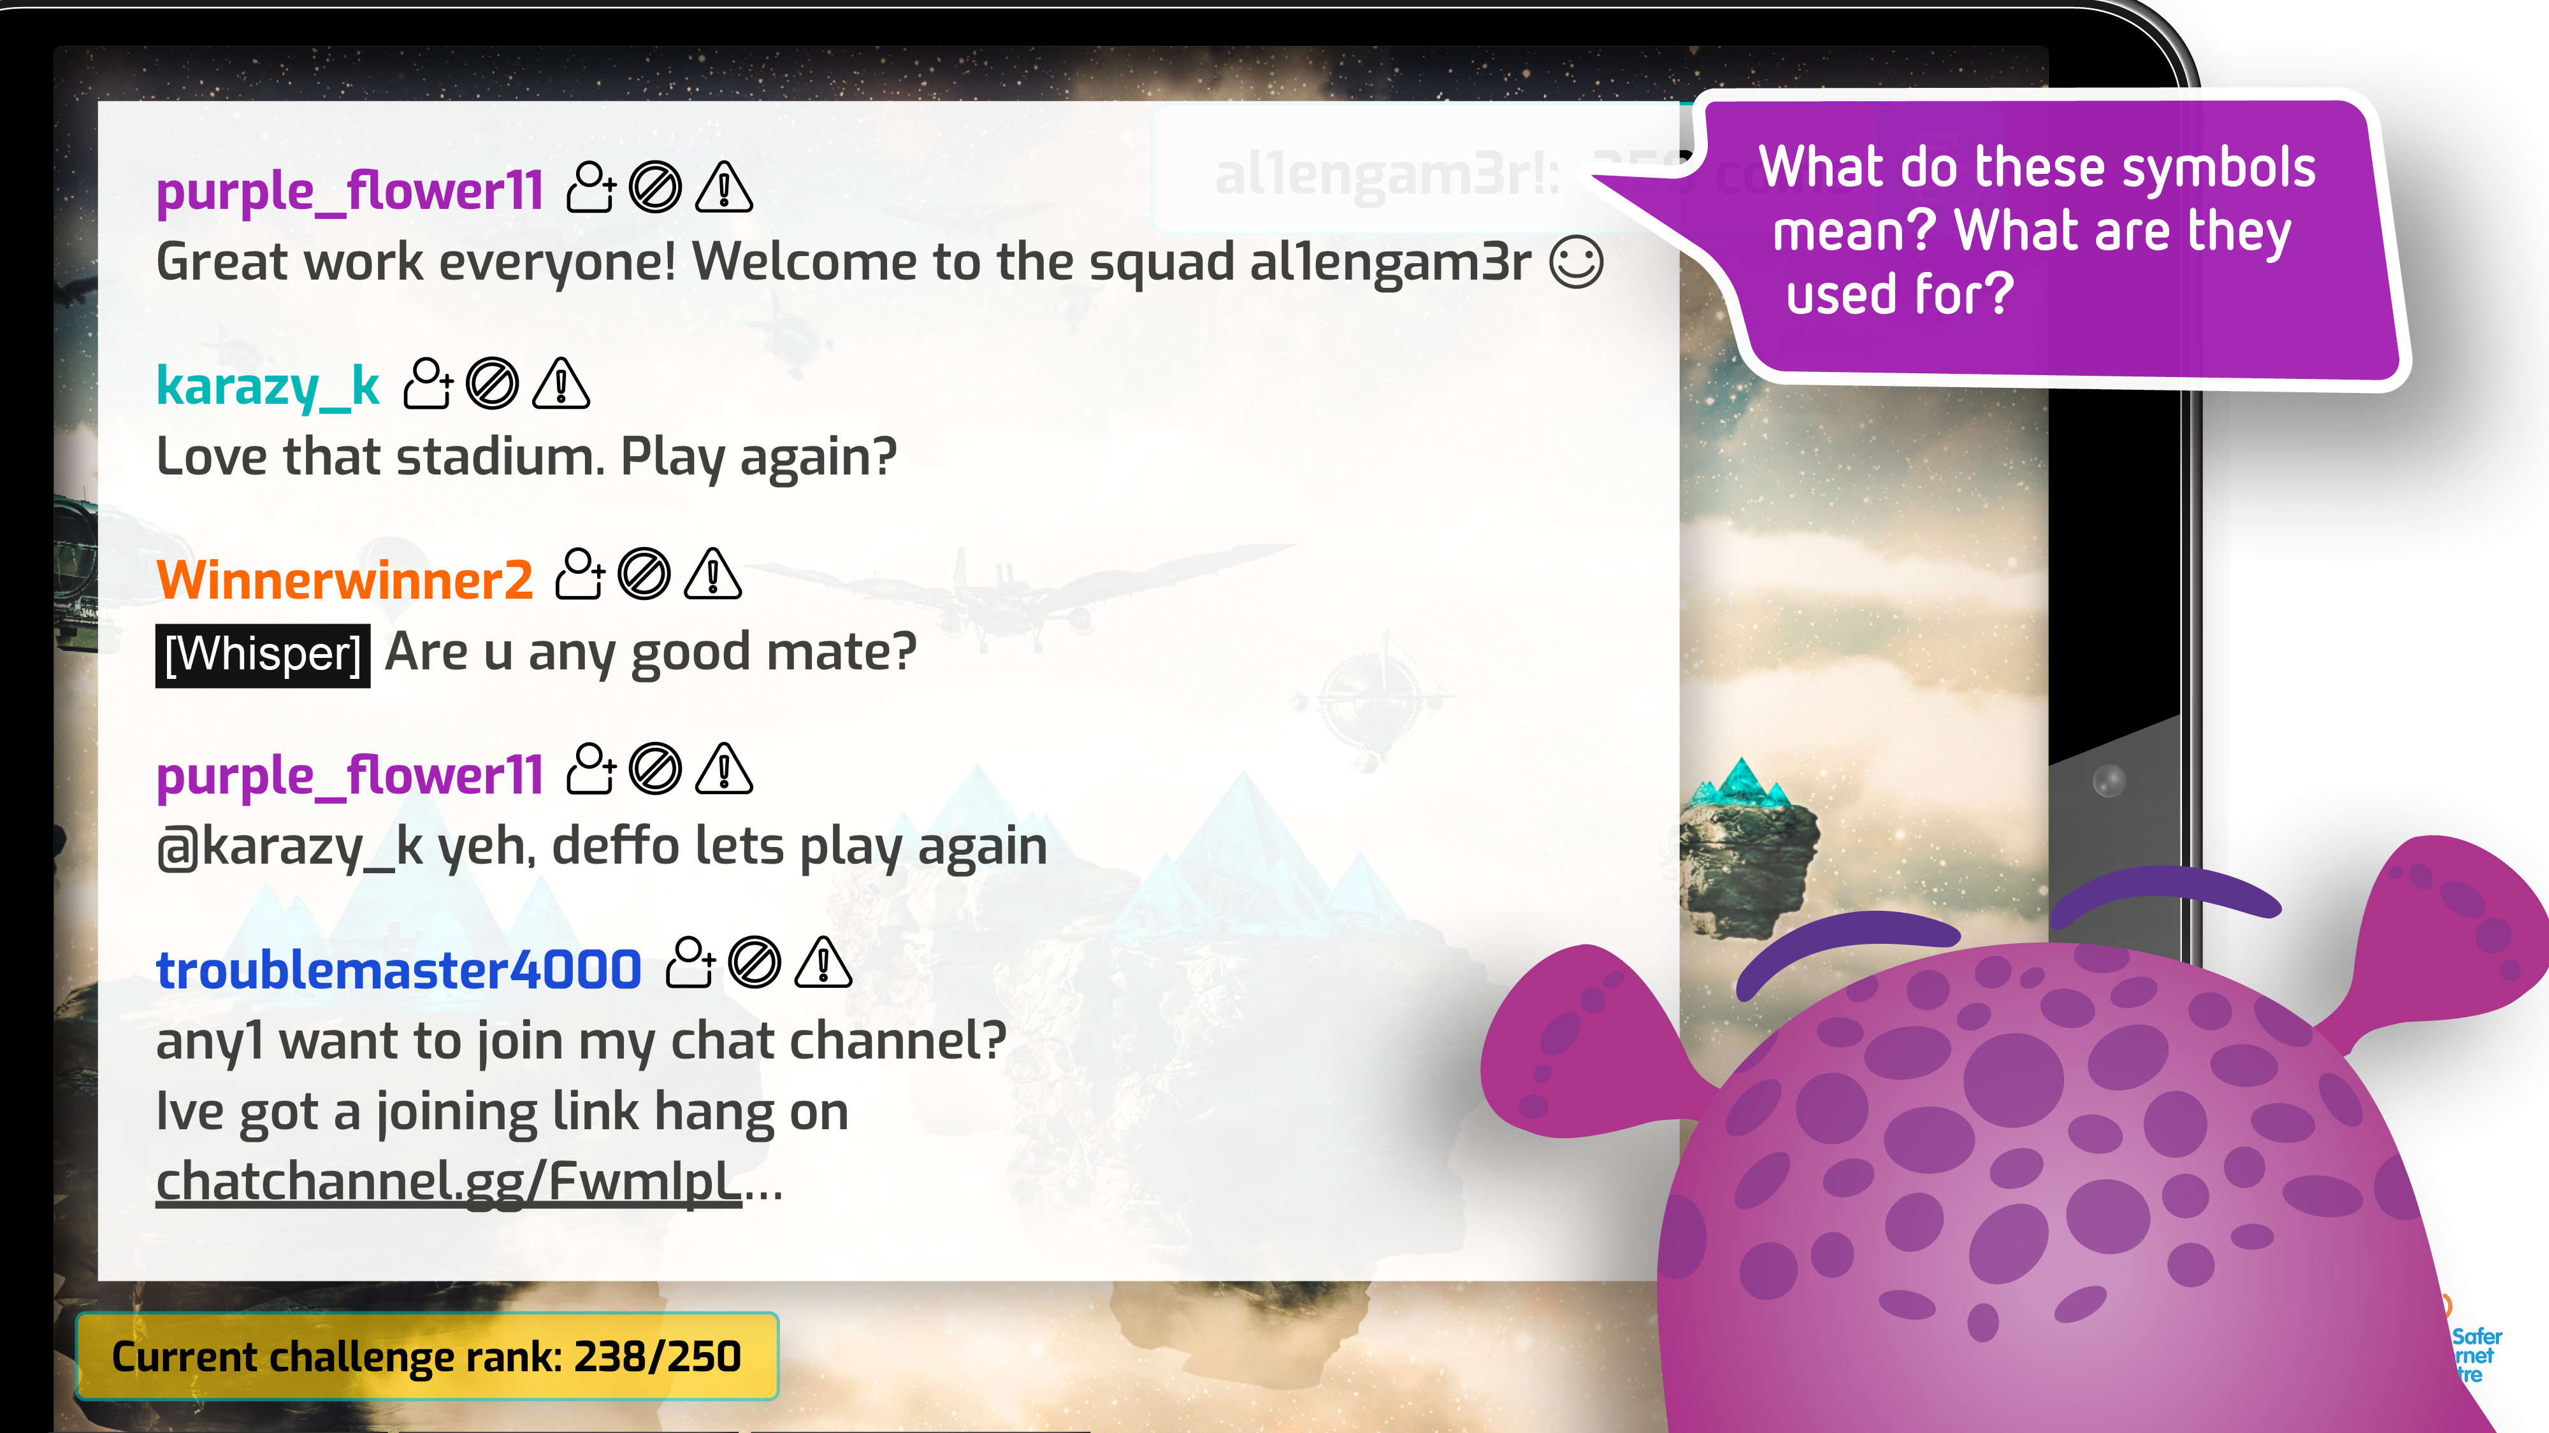
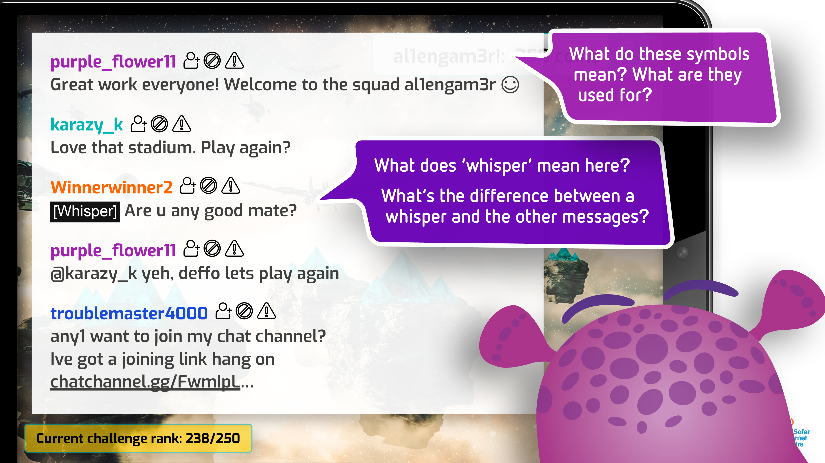
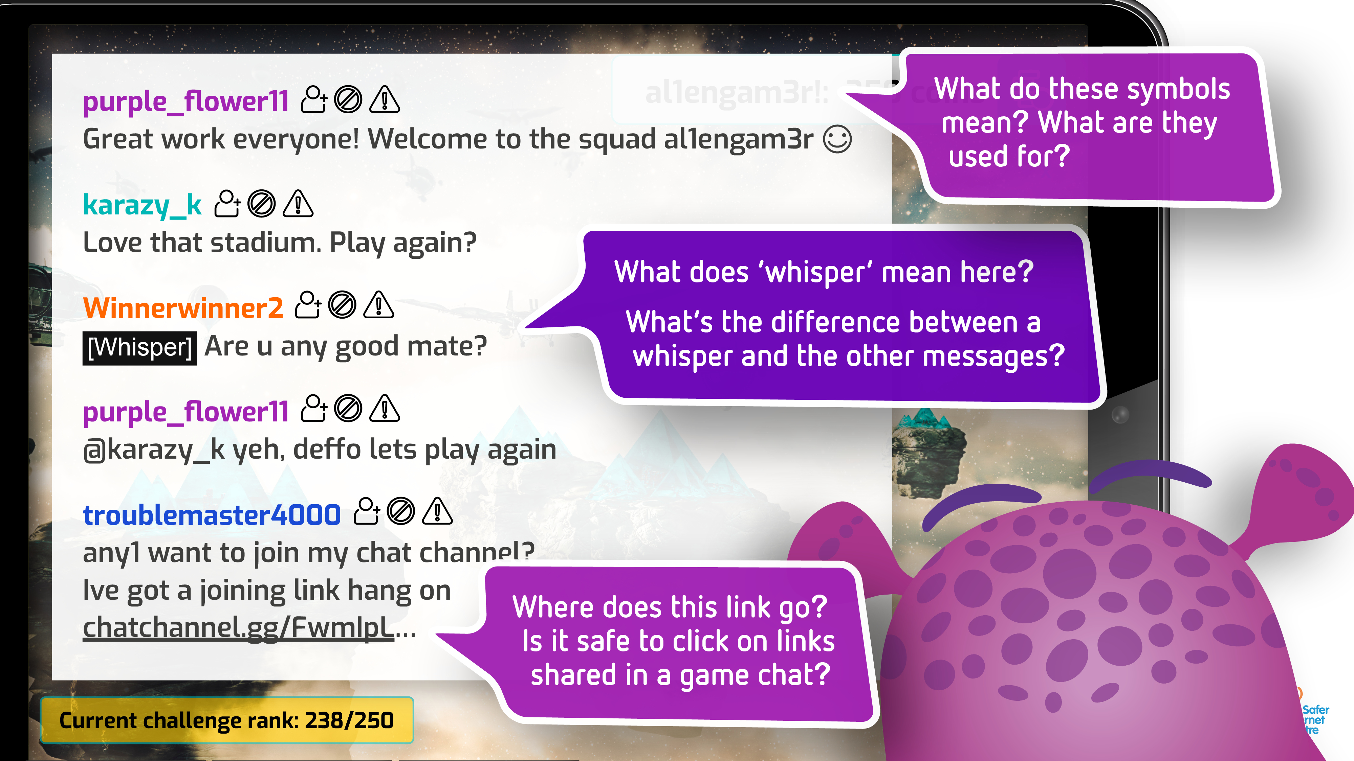

Slide 14
Hi everyone,
I’m having the best time on Earth! I love how each game is different – in some you build, some you race, some you roleplay. My favourite is when you work together as a team to win.
I have noticed one thing though… some of the other players REALLY want to win. It can feel like a lot of pressure! One time someone even said that if we lost, they’d hunt me down! I guess I just need to keep practising…
Wish you were here xx
Planet Gnimag
2nd galaxy on the left Ybax Cluster
Outer Space

Slide 15
Giving advice to a player under pressure
Giving advice to a player putting others under pressure
Can you explain why putting others under pressure isn’t kind or helpful?
What can players do to help other members of their team play at their best?
What could someone do if they are stressed about winning a game and finding this difficult to manage?
What would you say to reassure a player who was feeling under pressure?
What could a player under pressure say to the person who is making them uncomfortable?
If asking someone to stop is too difficult, what else could they do?

Slide 16
Giving advice to a player under pressure
Giving advice to a player putting others under pressure
Can you explain why putting others under pressure isn’t kind or helpful?
What can players do to help other members of their team play at their best?
What could someone do if they are stressed about winning a game and finding this difficult to manage?
What would you say to reassure a player who was feeling under pressure?
What could a player under pressure say to the person who is making them uncomfortable?
If asking someone to stop is too difficult, what else could they do?

Slide 17
Hello everyone!
Thank you for looking after me during my holiday on Earth! I had THE BEST time learning about online games, respect and relationships with you. Did you enjoy it as much as I did?
I’ve been telling everyone here about how fun playing games and using the internet can be. In fact, I’ve talked about it so much that something VERY exciting has happened… The Planet Gnimag Technology Council have agreed that I can start an online gaming community here. I get to introduce lots of new players to online gaming!
I need your help one last time… they’ve asked me to start by writing some guidelines to help make sure that everyone here on Planet Gnimag feels safe, happy and respected when playing together online. Have you got any ideas of what I could include?
Let me know! Talk soon

