Slide 1



Sustrans School Programme
Active Travel Adventure Story
Suitable for: All
You will create a story about your own adventure using only human power – that’s walking, cycling, skating, scooting, in a wheelchair or any other human powered device.
You will need
Imagination
Pen and paper
Coloured pens and pencils
Extra activity
You could extend the images that you have thought of in your story into an artwork (see page 4)! If you use scissors to cut artwork out please ask an adult to help.

Slide 2
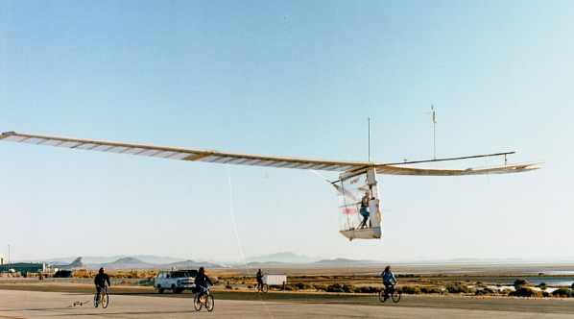
Instructions
Create an adventure story that you went on using human power – that is cycling, skating, walking, scooting or in a wheelchair. You could even invent your own human powered machine! (Why not check out the MacCready Gossamer Condor for some inspiration!).
As a guideline you could answer these questions:
  Where did you go and why did you go there?
  How did you plan for the trip?
  What did you take with you?
  How did you keep safe whilst on your adventure?
  How did you overcome a challenge on your adventure?
  Who might you take with you on your adventure?

Slide 3

Top Tips!
Do we need safety gear if you are using a bike, or scooter?
Are there any special snacks that I would need for a human powered journey?
Do we need to take anything in case we get lost?
Do we need anything if we are out at night?
What is the safest route? Which route has the cleanest air?
What would we need if we got a puncture or any other mechanical issues?

Slide 4
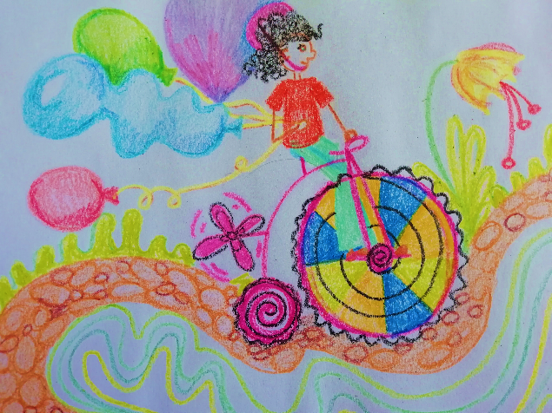
Active Travel Adventure Poster
This is an example of an artwork that you can create as an extra activity to your story. Have fun making your own!
Snippet from Active Travel Adventure linked to image above:
My balloons blew in the wind that was created by my pedal powered propeller. It was so amazing to skim along the pebbled path and twisting around the corners. As I passed a freshly blossomed flower I was glad that I was using my own human powered machine…

