Slide 1
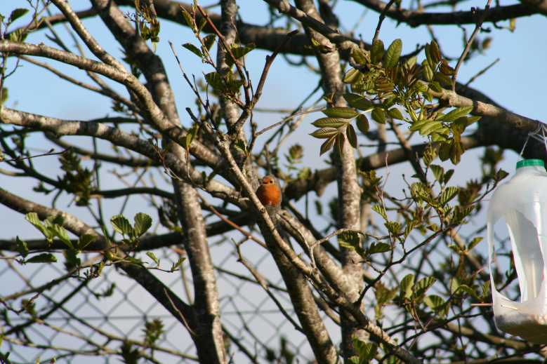
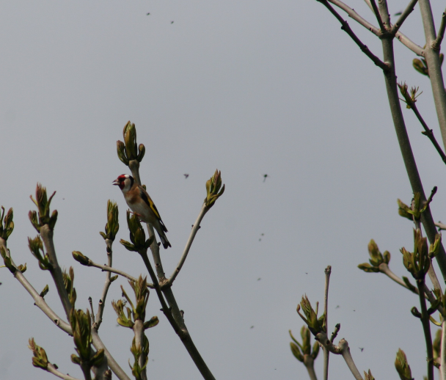
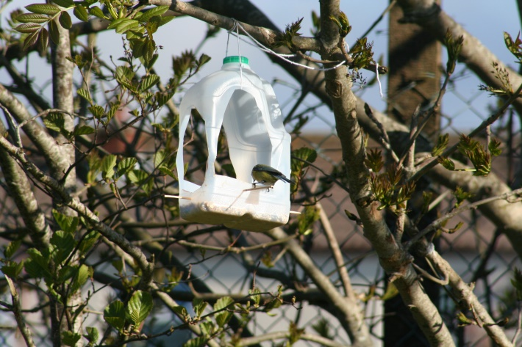
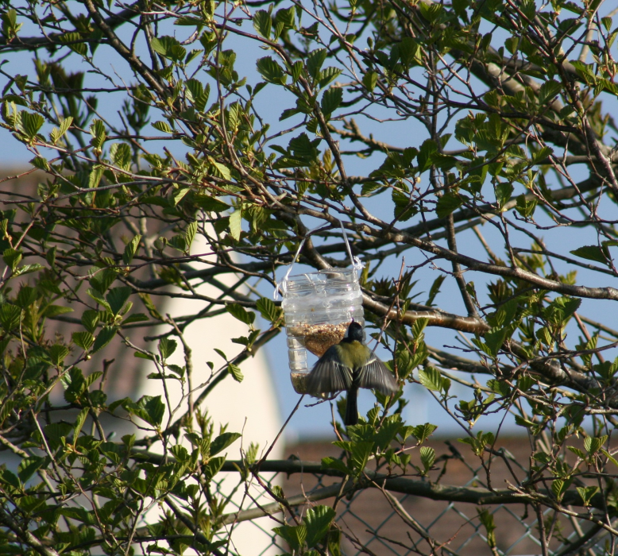
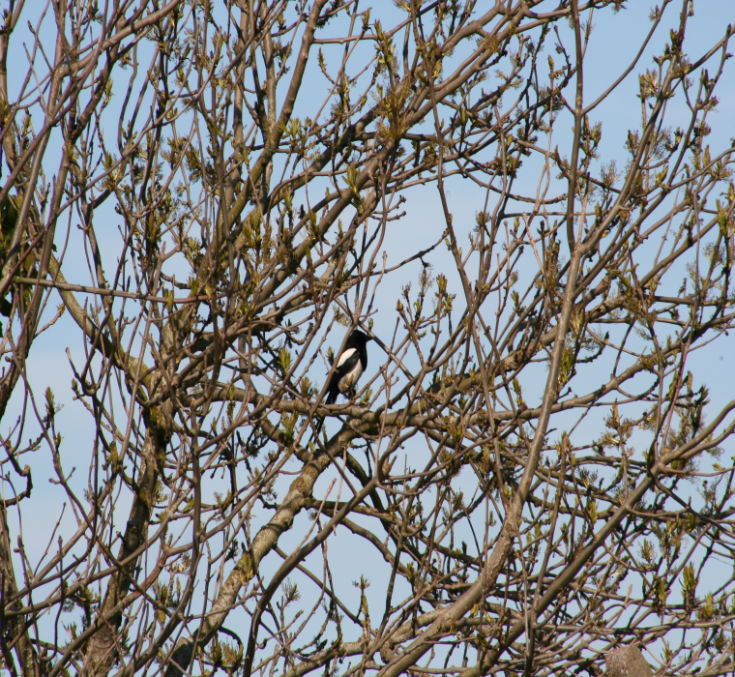
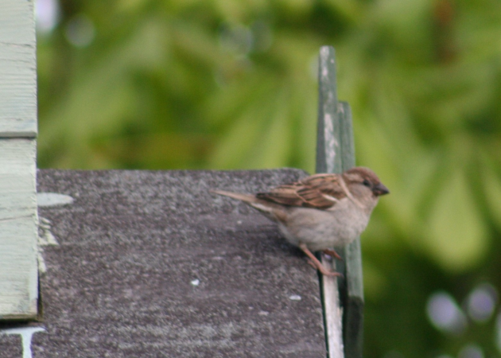
Topic: Birds in my garden
By Dara Byrne-Convery

Slide 2
Introduction
As part of my school work I am looking at types of birds and especially those in my own garden. I have built various bird feeders and boxes so I could get a closer look at them. I researched some of the birds that I have found and took photos with the help of my family to show what I have found.

Slide 3
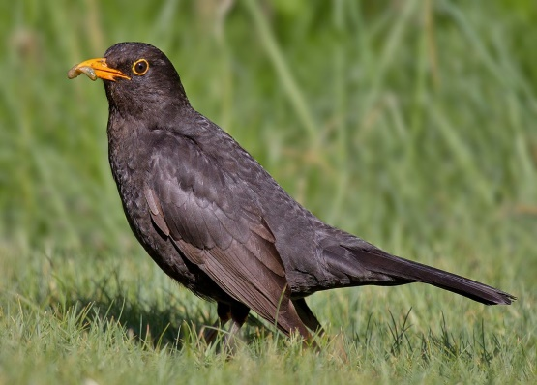
Blackbird
Blackbird’s scientific name is Turdus Merula they come from the bird’s family of thrushes. The males live up to their name but confusingly, females are brown often with spots and streaks on their breasts the bright orange –yellow beak and eye-ring make adult male blackbirds one of the most striking garden Birds. One of the UK most common its mellow song is also a favourite.
These bird seat insects worms and berries there measurements are 24-25cm, wingspan 34-38 5 cm, weight 80-100g, blackbirds
Blackbirds are found everywhere in gardens and countryside and from coasts to hills although not on the highest peaks. So to enjoy the outside world in all that is going on go and listen to these lovely birds in your garden or back yard and enjoy.

Slide 4
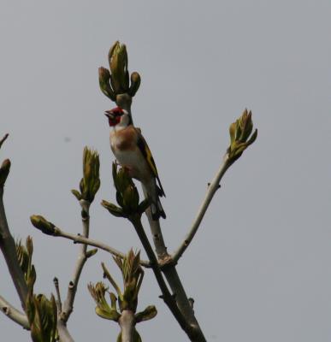
Goldfinch
Goldfinch scientific name Carduelis carduels, from the finch bird family. The goldfinch is a highly coloured finch with a bright red face and yellow wing patch . Sociable, often breeding in loose colonies, they have a delightful liquid twittering song and call.
Their long fine beaks allow them to extract otherwise inaccessible seeds from thistles and teasels. Increasingly they are visiting bird tables and feeders .in winter many UK goldfinch migrate as far south as Spain . They eat seeds and insects in summer. There measurements are length 12cm wingspan 21_25 5cm weight .
Goldfinches can be seen anywhere there are scattered bushes and trees, rough ground with thistles and other seeding plants. Like orchards, parks, gardens and heathland. Lesson common in upland areas and most numerous in southern England.
This picture is of goldfinch in my a tree in my back garden
cartab

Slide 5
Wood Pigeon
The common wood pigeon is a large species in the dove and pigeon family. It belongs to the genus Columba and, like all pigeons and doves, belongs to the family Columbidae. It is locally known in southeast England as the “culver”. This name has given rise to several areas known for keeping pigeons to be named after it, such as Culver Down.
The common wood pigeon may be identified at once by its larger size at 38-44.5 cm(15.0-17.5 in) and weight 300-615 g ((10.6-27.7 oz), and the white on its neck and wing.
Most of its diet is vegetable, round and fleshy leaves from Caryophyllaceae, asteraceae, and cruciferous vegetables taken from open fields or gardens and lawns.

Slide 6
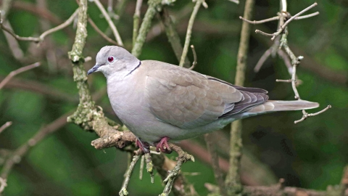
Collared Dove
This scientific name Streptopelia decaocto and its bird family to pigeons and doves. Collared dovers are pale, pinky-brown grey colour, with a distinctive black neck collar. The have deep red eyes and reddish feet. Their monotonous cooing will be a familiar sound to many of you. Although you’ll often see them on their own or in pairs, flocks may form where there is a lot of food available like.
They eat seeds, grains, buds and shoots. Their measurements length 32cmwingspan 51cm weight 200g. Collared doves can be seen just about anywhere, but often around towns and villages. They’re common visitors to gardens. But collared doves only came to the UK in the 1950s, after a rapid spread across Europe from the Middle East

Slide 7
Feeders, Bird boxes and egg
I have attached some photos of the hand made feeders and bird boxes that I have made from recycles and resources around my home. I also made a egg out of jelly using a goose egg shell with the help from family. I had lots of fun doing this.

Slide 8
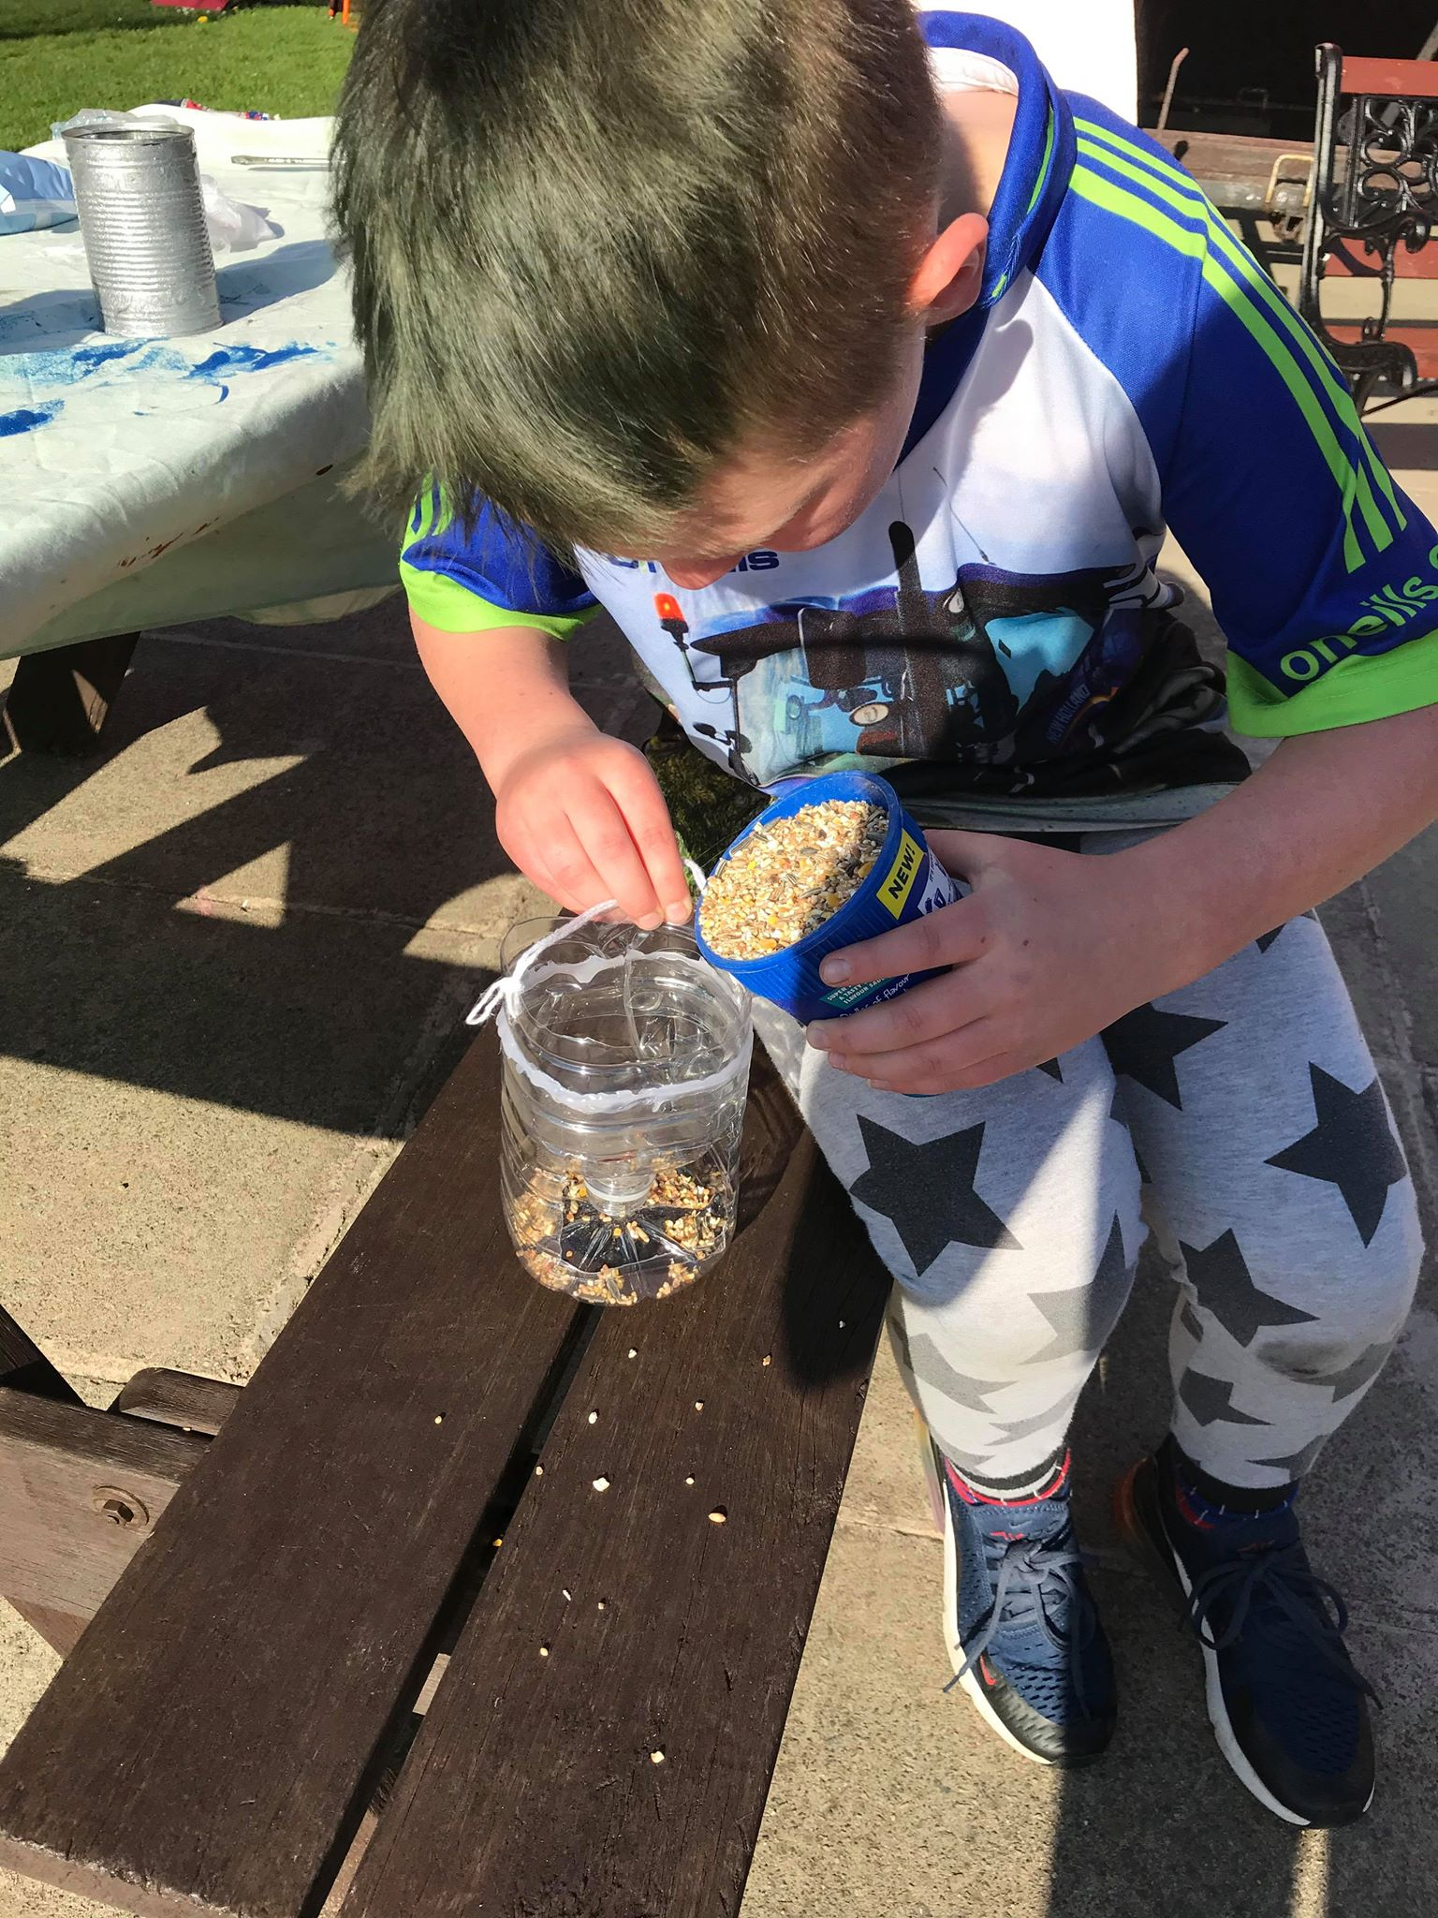
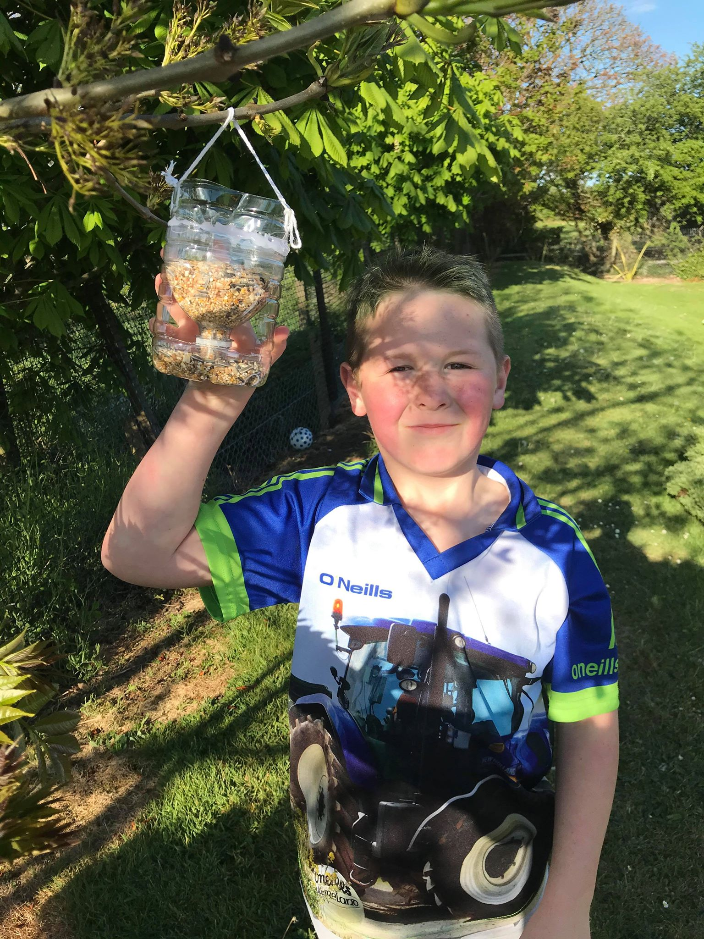

Slide 9
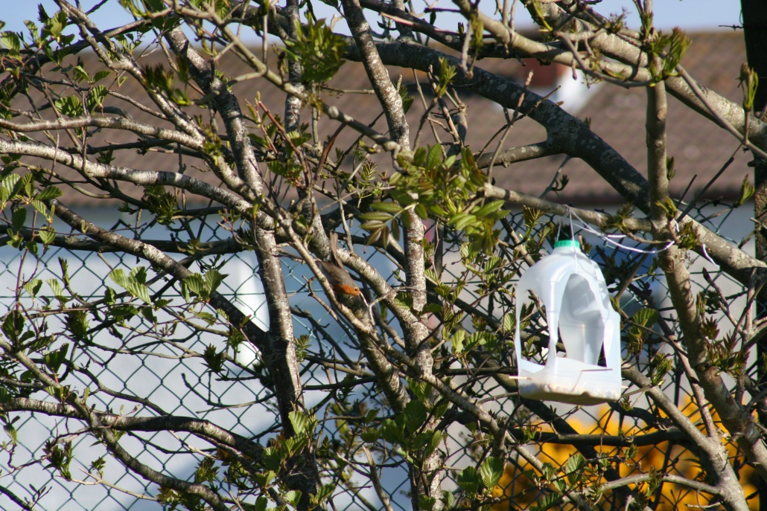
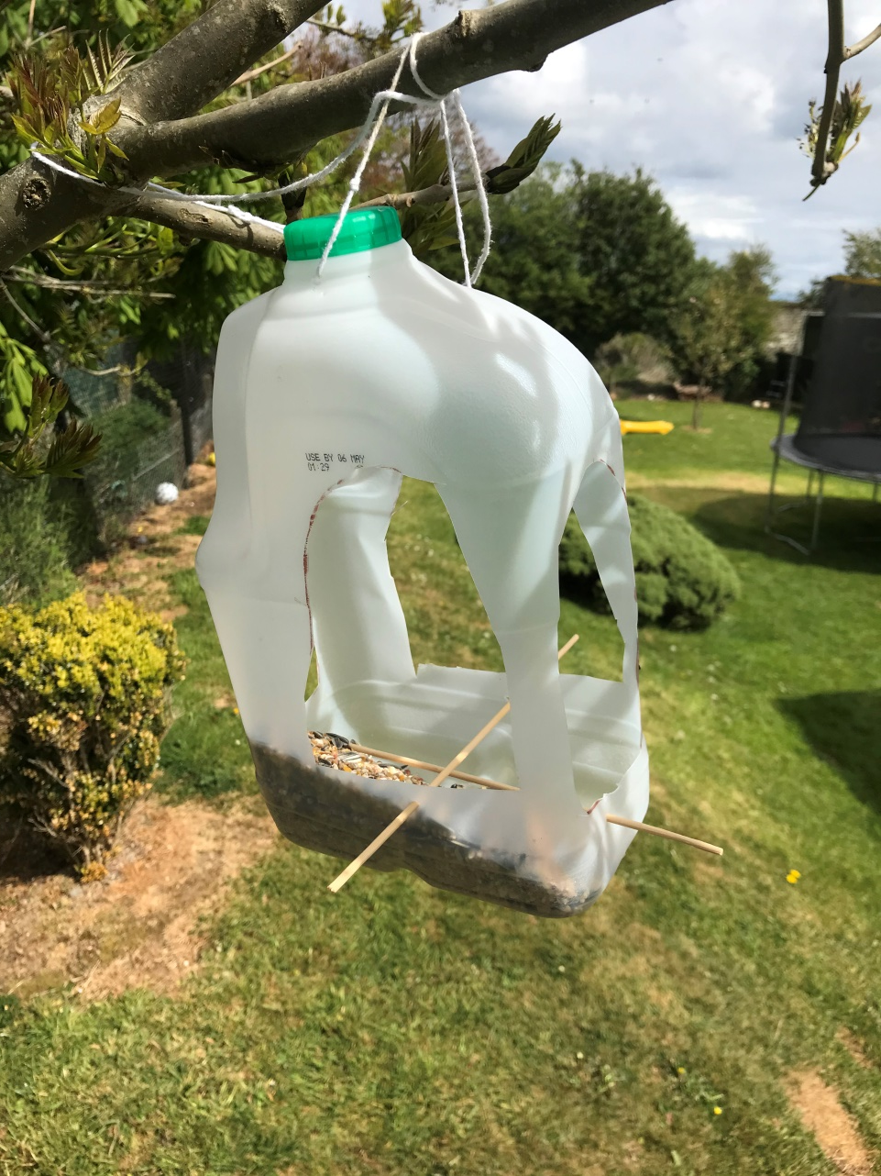
Easy made bird feeders from old drink bottles and milk cartons. These helped me get some great pictures of the birds in my garden. I love seeing the birds eating from them. The robin is in the picture above can you find him!

Slide 10
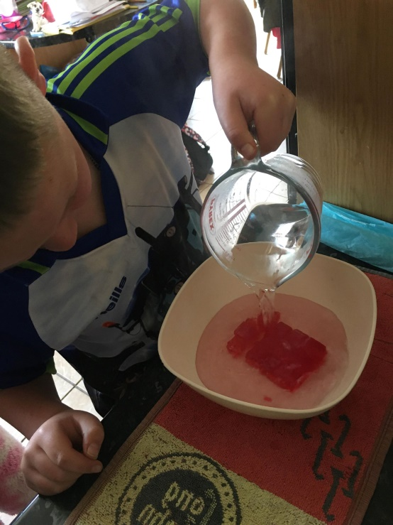
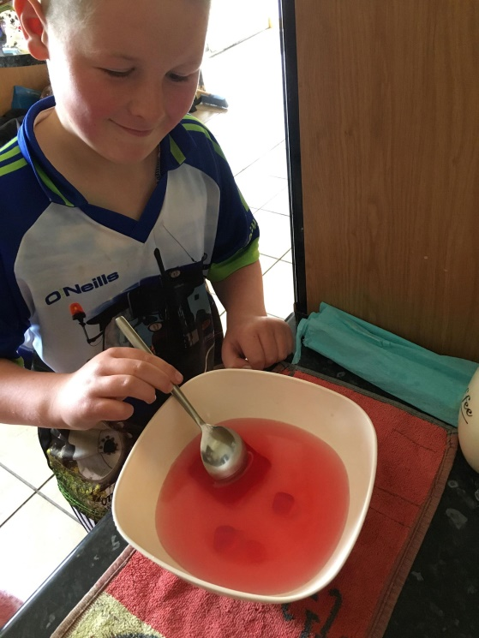
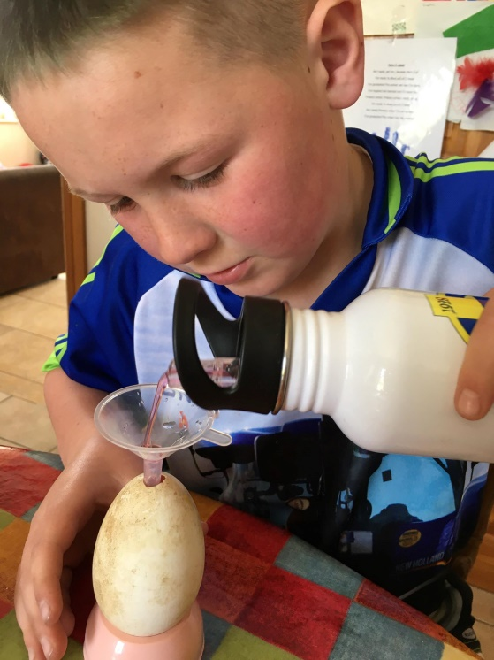
Making a goose egg out of jelly
Get Jelly cubes and some hot water
Stir with spoon until all cubes have gone
Pour the water jelly into small hole at top of egg and put in fridge to set

Slide 11
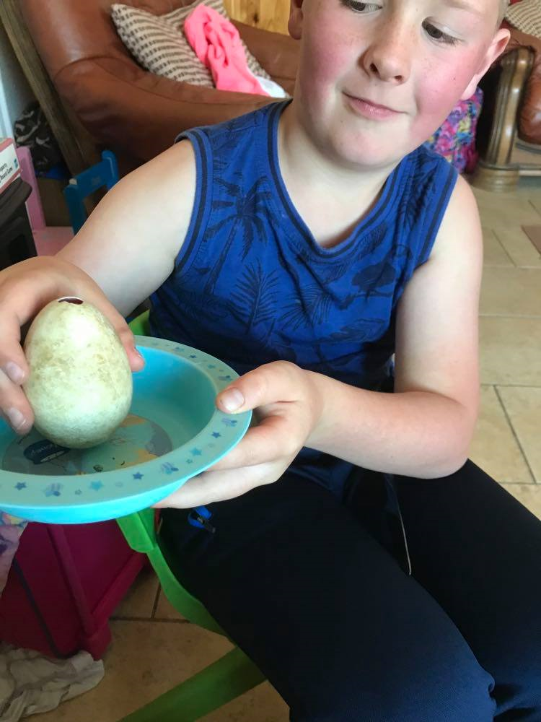
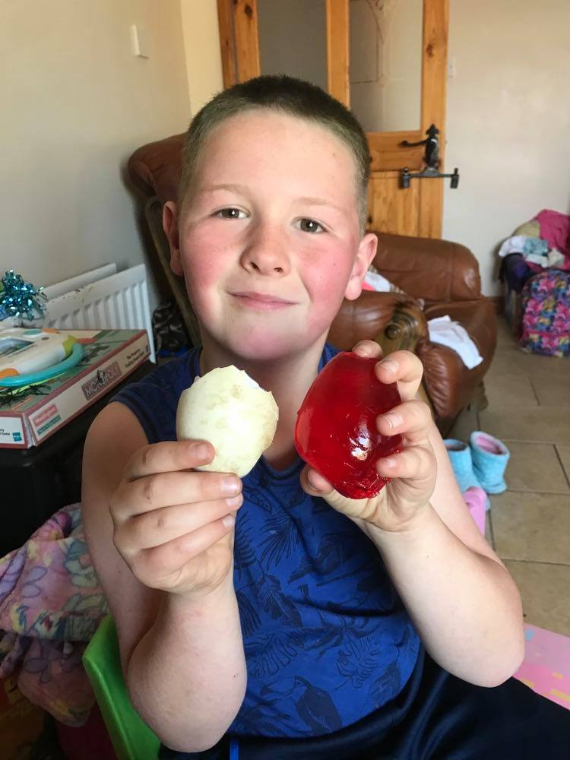
The finish egg

Slide 12
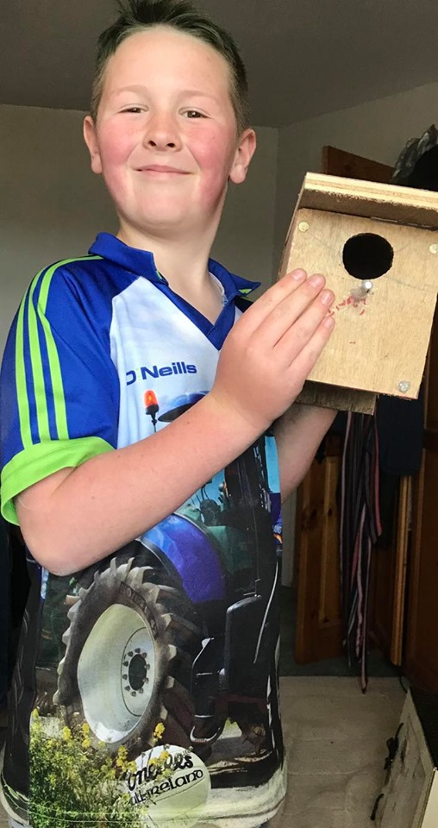
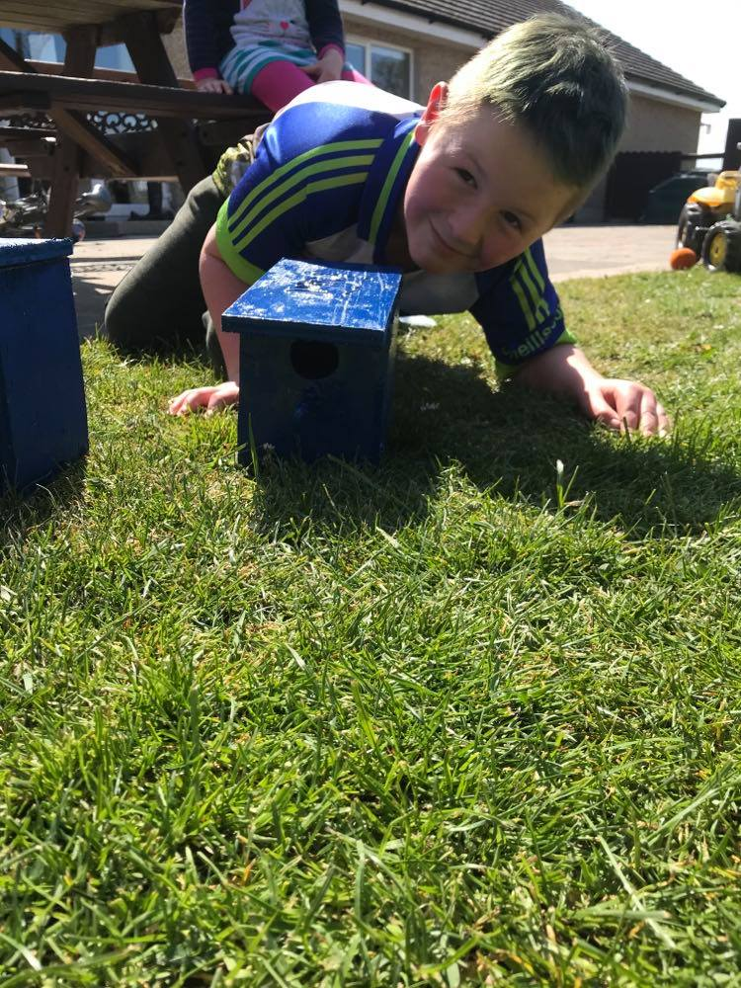

Slide 13
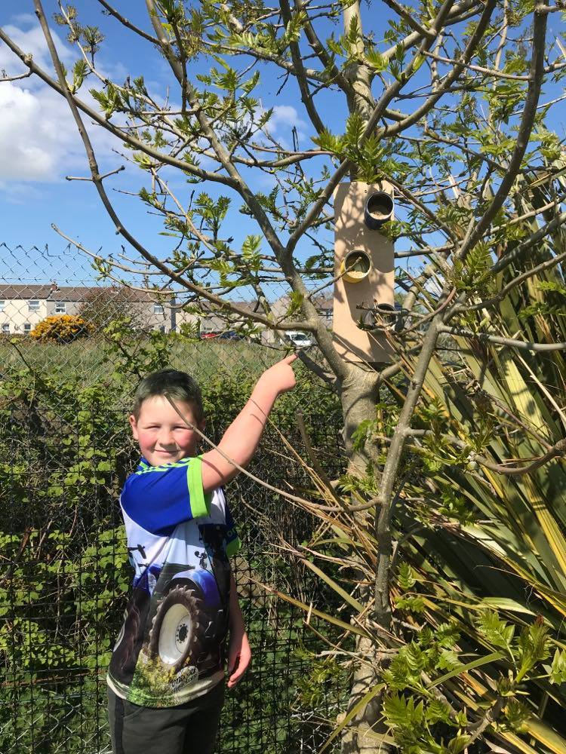
Easy made tin painted bird feeders (painted different colours to attract the birds) put to a piece of wood and put high in the tree. Reusing and recycling items can help the environment and help the animals and save our planet. It is a win for everyone!

Slide 14
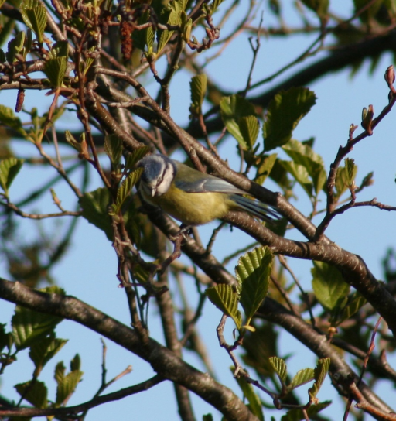
Blue Tit
Scientific name Cyaniste caeruleus birds family tits. A colourful mix of blue yellow white and green makes the blue tit one of our most attractive and most recognisable garden visitors. In winter, family flocks join up with other tit as they search for food. A garden with four or five blue tits at a feeder at any one time may be feeding 20 or more. they eat insects, caterpillars, seeds and nuts. There measurements length 12cm wingspan 18cm and weight 11g. Blue tits are common in woodland, parks and gardens. They're widespread and found across the whole of the UK with the exception of some Scottish islands.
This is a picture of a blue tit in my garden.

Slide 15
Robin
Their scientific name Erithacus rubecula and they are from the bird family of Old World flycatchers and chats. The UK’S favourite bird – with its bright red breast it is familiar throughout the year and especially at Christmas! Males and females look identical and young birds have no red breast and are spotted with golden brown. Robins sing nearly all year round and despite their cute appearance, they are aggressively territorial and are quick to drive away intruders. They will sing at night next to street lights. They eat worms, seeds, fruits, insects and other invertebrates.
Their measurements are 14cm length, wingspan of 20-22cm and weights 14-21g. This bird species has different identifying features depending on sex/age/seasons. Robins live across the UK in woodland, hedgerows, parks and gardens.
This picture is of one of the robins that are regular visitors to my garden to eat from my feeders and the grass.

Slide 16
Magpie
Magpies scientific name is Pica pica and are from the birds of the Corvidae family.From a distance the magpie is a black and white crow with a long tail. The tail accounts for over half the total length of the bird and is an indication of the bird’s status in its society. The head, breast and back are black, the shoulders patches, belly and flanks are white. The black wings and tail, however, are a beautiful glossy, iridescent blue, green and purple. The bill and legs are black.
Magpies are very vocal birds, but the harsh repeated chattering “chacker chacker” call of the magpie is unmistakable. Their measurements are 44-46cm in length, wingspan of 52-60cm and weight 200-250g. They have quite a varied diet in their original rural habitat – insects, rodents, carrion, eggs and nestlings, grain, berries and fruit. The magpie is a very intelligent bird and always has a sharp eye of its food and also shiny objects of its nest. Magpies are sedentary birds, rarely moving far from their birth place.
This magpie was born in the tree in my garden and now lives there with its mate.

Slide 17
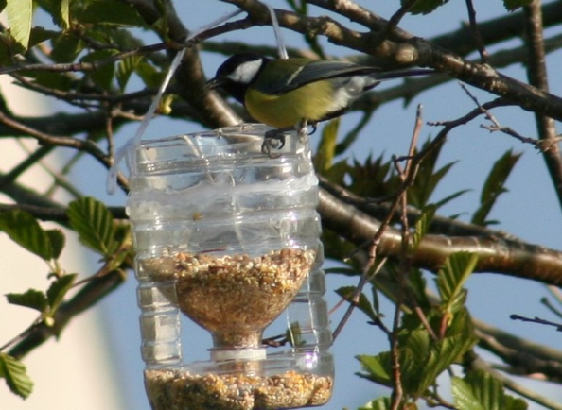
Great Tit
The great tit is a passerine bird in the tit family Paridae. It is a widespread and common species throughout Europe, the Middle East, Central and east across the Palearctic to the Amur River. The great tit is a distinctive bird with a black head and neck, prominent white cheeks, olive upperparts and yellow underparts, with some variation amongst the numerous subspecies. It is predominantly insectivorous in the summer, but will consume a wider range of food items in the with months.
The great tit has adapted well to hum changes in the environment and is common and familiar bird in urban parks and gardens. The great tit is large for a tit at 12.5 -14cm in length and has a very distinctive appearance that makes it very easy to recognise. It is a very vocal bird and has up to 40 types of calls and songs. The call are generally the same between sexes but the male is more vocal.
The great tit is generally not migratory. Pairs will usually remain near or in their territory year round, even in the northern parts of their range. Young birds will disperse from their parents territory, but usually not far.
This picture is in my back garden of a great tit eating from my homemade bird feeder

Slide 18
Tally of birds in my garden
Bird watch in Lismore Road Ardglass
Types of Birds
 | Blackbird | Goldfinch | Wood Pigeon | Collared Dove | Blue Tit | Robin | Magpie | Great Tit | Starling
Days of week
Monday | 5 | 2 | 1 | 1 | 2 | 1 | 2 | 2 | 1
Tuesday |  |  |  |  |  | 1
Wednesday | 2 | 2 |  |  | 2 | 1 | 1 | 1
Thursday | 1 |  |  | 1 |  | 2 |  |  | 12
Friday | 2 |  | 1 |  | 3 | 1 | 1 | 2 | 13
Total | 10 | 4 | 2 | 2 | 7 | 6 | 4 | 5 | 26

Slide 19
Graph of tally

Slide 21
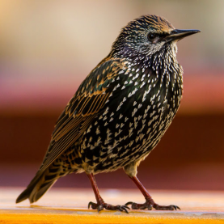
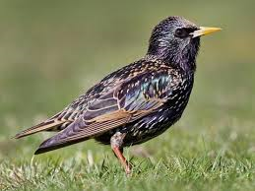
Starlings
British Starling
Scientific name sturuns vulgaris they are bird family starling. Smaller than blackbirds, with a short tail, pointed head, Triangular wings, starlings look black at a distance but when seen closer they are very glossy with a sheen of purples and greens. Their flight is fast and they walk and run confidently on the ground. Noisy and gregarious, starlings spend a lot of the year in flocks. Still one of the commonest of garden birds, its decline elsewhere makes it a Red List species.
They eat invertebrates they measurements length 21cm wingspan 37-42cm weight 75-90g. Starlings are conspicuous and widespread in the UK, occurring everywhere except for the highest parts of the Scottish Highlands. They are most abundant. In southern England and are more thinly distributed in upland areas with moorland. Still one of the UK’s commonest garden birds. In winter, huge roosts can be found in plantations, reed beds and city centres.
European Starling
In comparison to the British starling that don’t migrate normally the European ones in spring will migrate and return to Eastern Europe. Large numbers of birds from northern Europe, Russia and Ukraine migrate south westwards or south eastwards in search of food due to cold harsh weather. Then in the autumn, when immigrants are arriving from eastern Europe, many of Britain's common starlings become territorial on their grounds and the increasing amounts have meant that the British Starlings move further afield for new breeding grounds or food. It has been known that most of these European birds will continue to migrate westwards until they have spread across the whole country and like our own residents flock to roosting in parks, reed beds or city centres.

Slide 22
Conclusion
From doing this project I learnt a lot about different types of birds in my garden. I enjoyed making feeders and boxes in order to watch them closer and bring more into the garden. My favourite bird out of the all that I have seen has to be the goldfinch because of its lovely red, gold and white colours they are bright and easy to spot. I also realised that they have to travel elsewhere if its hard to find food. I would say to everyone to have bird feeders or boxes to make sure birds stay in our gardens and help our plant life grow.

